Slide 1
Lecture 1: Overview – Digital Concepts

Slide 2
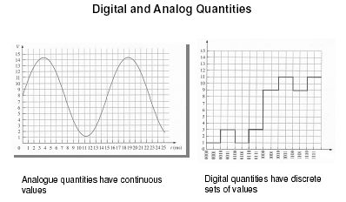

Slide 3
Binary Digits, Logic Levels, and Digital Waveforms
The conventional numbering system uses ten digits: 0,1,2,3,4,5,6,7,8, and 9.
The binary numbering system uses just two digits: 0 and 1.
The two binary digits are designated 0 and 1
They can also be called LOW and HIGH, where LOW = 0 and HIGH = 1

Slide 4
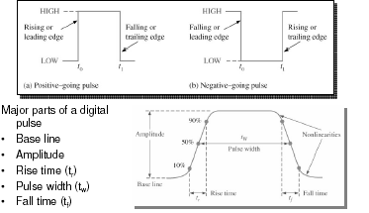
Binary Digits, Logic Levels, and Digital Waveforms
Binary values are also represented by voltage levels

Slide 5
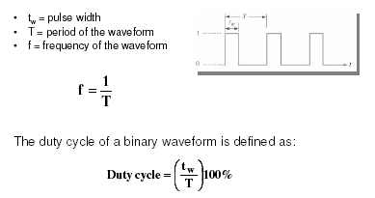
Binary Digits, Logic Levels, and Digital Waveforms

Slide 6
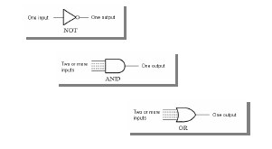
Basic Logic Operations
There are only three basic logic operations:

Slide 7
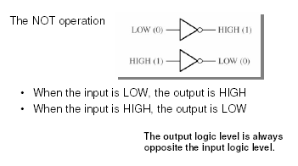
Basic Logic Operations

Slide 8
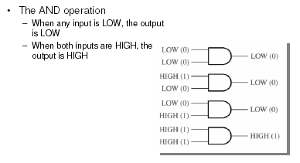
Basic Logic Operations

Slide 9
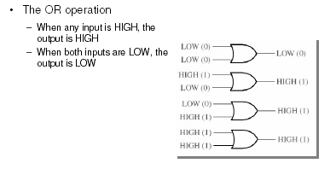
Basic Logic Operations

Slide 10
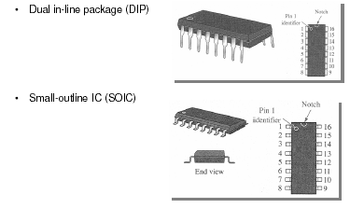
Fixed-Function Integrated Circuits

Slide 11
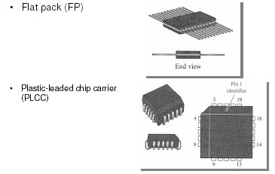
Fixed-Function Integrated Circuits

Slide 12
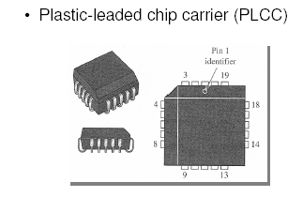
Fixed-Function Integrated Circuits

Slide 13
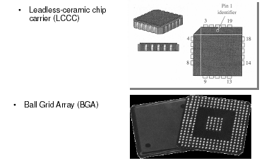
Fixed-Function Integrated Circuits

Slide 14
History
The first electronic logic was implemented using valves or relay as switches
– slow by today's standards
– large
– got hot
– relatively unreliable
Transistor switches used now
– many transistors can be "integrated" onto a single chip of silicon
– fast (switch on and then off in around < 100 picosecond)
– very small (order of 0.1 micron)
– can get warm
– very reliable

Slide 15
Example Applications
Design Example:
Numeric
– Calculators for addition, multiplication etc.
– Aircraft navigation systems for calculating position, ETA etc.
– Computers for averaging your exam marks
Non-numeric
– Parking meters for timing
– Satellite TV encoding and decoding for revenue
protection

